Slide 1
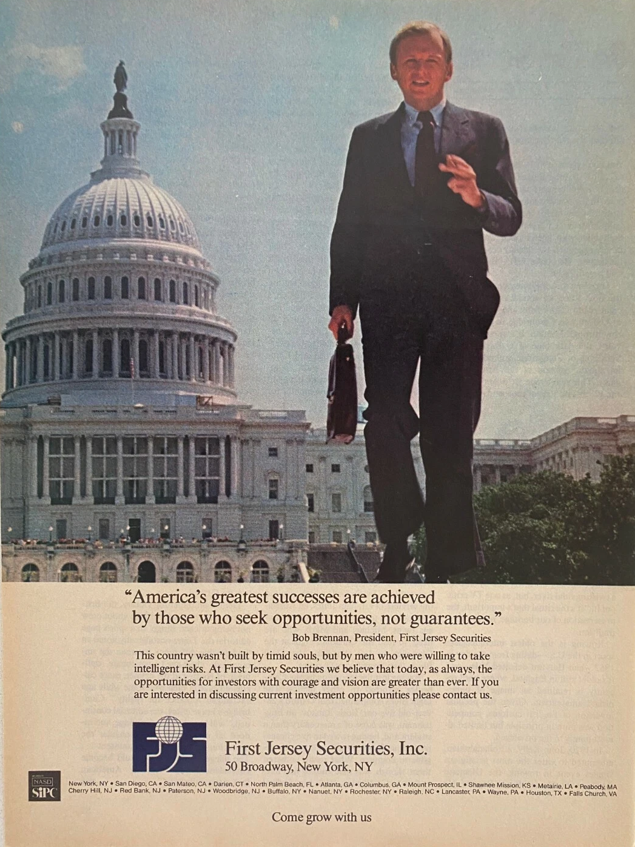
Robert Brennan – First Jersey Securities (1995-2001)
William Cosgrove

Slide 2
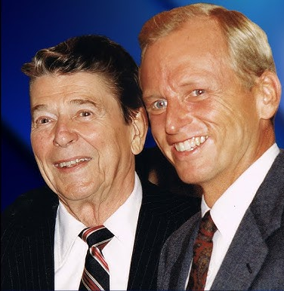
How the Business Worked
Robert Brennan: founder and CEO of First Jersey Securities
  (Specialized in promoting penny stocks to normal, everyday buyers.)
First Jersey Securities played the role of a market maker
  They would buy and hold stocks of small, often unheard-of companies.
  FJS brokers promoted these stocks aggressively to their average, “retail” customers.
Issue → They controlled both pricing and distribution

Slide 3
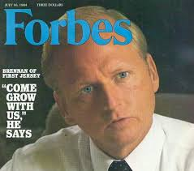
Scandal?
FJS bought shares of small, random, and obscure companies for a very low price. → Pennies
Resold them to their customers, at an undisclosed, extreme markup.
The brokers used high-pressure sales tactics, forcing their unsuspecting customers to buy.
Customers believed the prices were legitimate, but FJS was actually setting and controlling the pricing in these markets.
Result: Customers paid far above the fair market value of the stocks, while FJS was making immense profit.

Slide 4
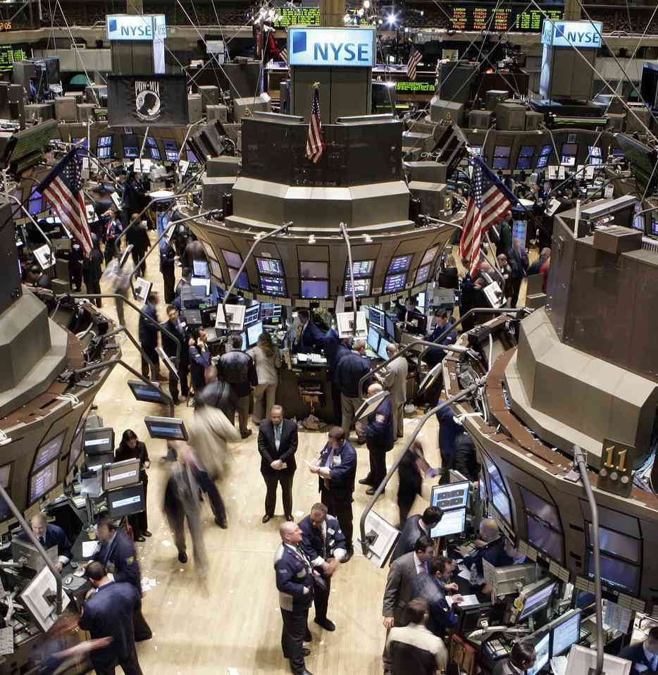
Who was Harmed?
1. Everyday Investors (Retail investors)
  Paid inflated prices for otherwise worthless, risky stock.
  Lost extreme amounts of money when selling off their stock
2. The Market System:
  Trust was weakened in the market → people less willing to invest
  Fair pricing impacted → Brennan created his own supply and demand, false sense of value
Main idea: The crimes were not victimless, real people lost money, and the basic trust in the Market System was lost.

Slide 5
Ethical Wrongs
Deception
01
Exploitation of the lack of customer knowledge
02
Deliberate business model built on misconduct
03
Main issue: Brennan and FJS profited through deception and manipulation
04

Slide 6
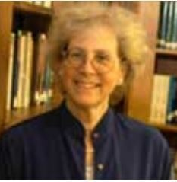
Elaine Sternberg:
Elaine Sternberg states that markets require:
  Distributive Justice → rewards are distributed within the company = DOES NOT APPLY
  ** Ordinary Decency → businesses must operate honestly and fairly, without any form of violence or coercion
Brennan and FSJ clearly violate Sternberg's principle of Ordinary Decency
  Mislead customers about true stock prices
  Charged hidden and extreme markups
  Exploited the lack of knowledge of said customers
By lacking Ordinary Decency, they violated the basic moral rules of the market, undermining trust and creating an unfair outcome.

Slide 7
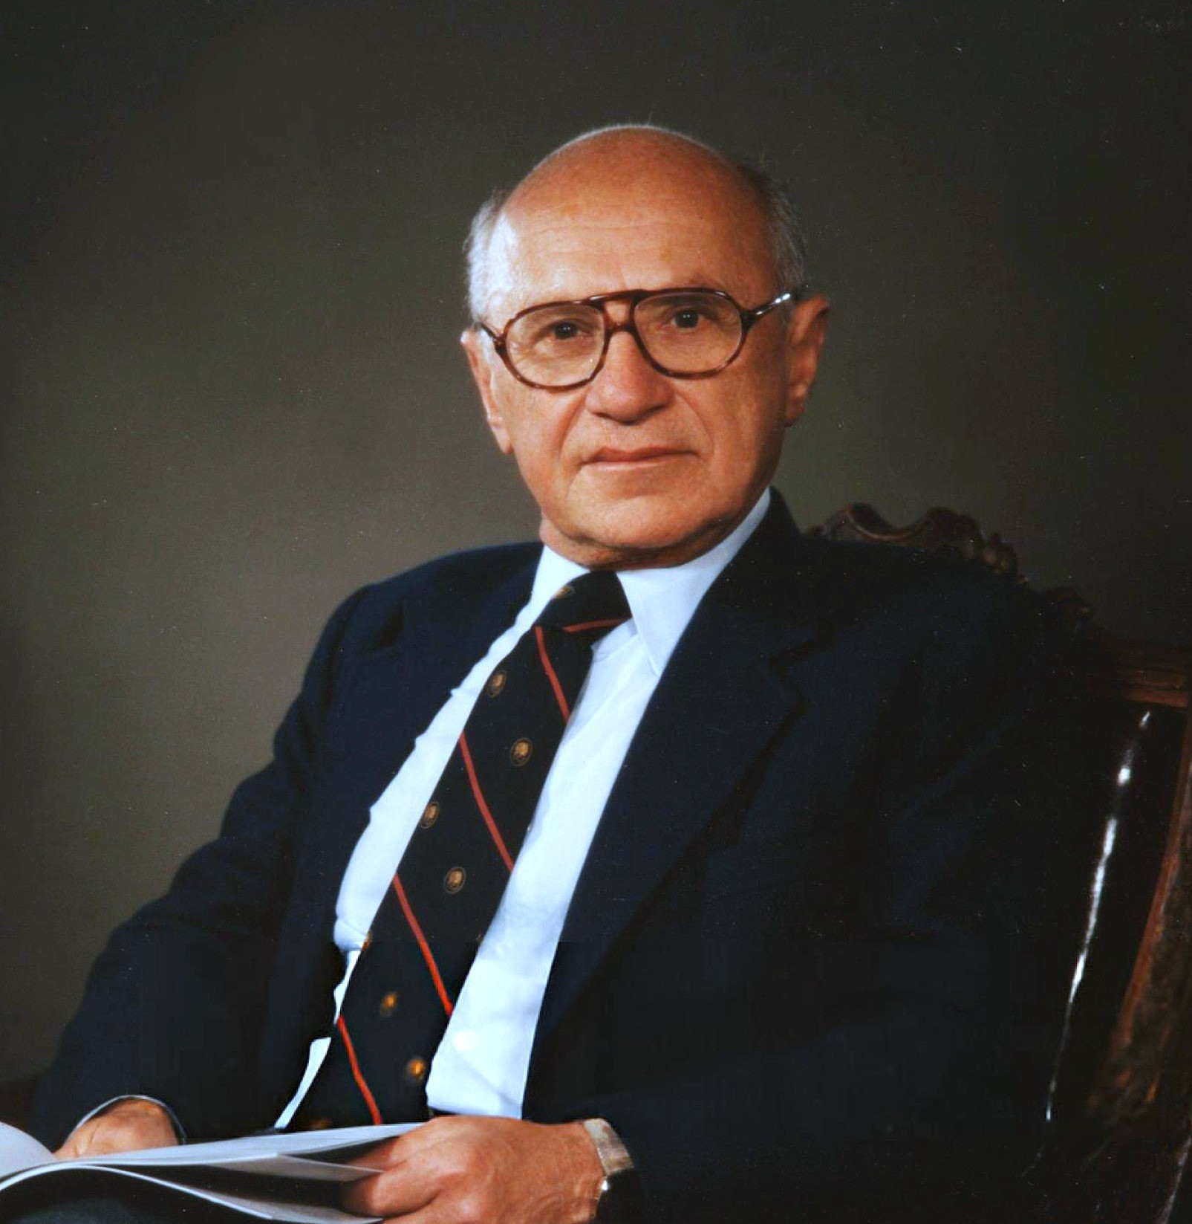
Milton Freidman:
Friedman: firms should maximize profits within the rules of the game.
Though certainly maximizing profit, Friedman was doing so through fraud and deception, clearly breaking the “rules of the game. ”
Clearly, not even Friedman could justify the immoral actions of Brennan.

Slide 8
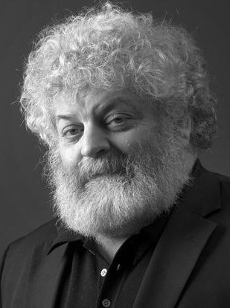
Edward Freeman:
Stakeholder Theory:
  Firms must consider ALL stakeholders.
  Customers = key stakeholders for Brennan and FJS.
FJS prioritized profit over customers, profiting off of deception of their own customers.
Wrong according to Freeman = FJS failed to create value for ALL stakeholders, hurting the customers.

Slide 9

Plan for the Paper
Part 1: Explain Brennan and FJS case in detail
Part 2: Identify ethical wrong (deception + exploitation)
Part 3: Apply:
  Sternberg
  Friedman
  Freeman
Part 4: Evaluate justifications, respond, counterarguments
Part 5: Conclusion

Slide 10
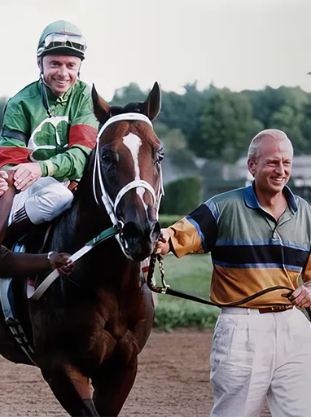
What Happened?
Brennan was investigated by the U.S. Securities and Exchange Commission for securities fraud
A judge ruled that he must pay $71.5 million in penalties and fines for securities fraud and banned from the securities industry.
What did he do after this?
  Declared bankruptcy, but concealed assets in offshore accounts in the Caribbean, and his golf club in NJ, and his stables.
  Found guilty of bankruptcy fraud and money laundering → Spent about 9 years in prison.

